Slide 1

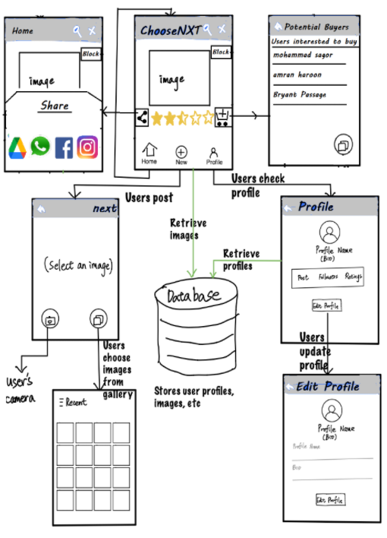
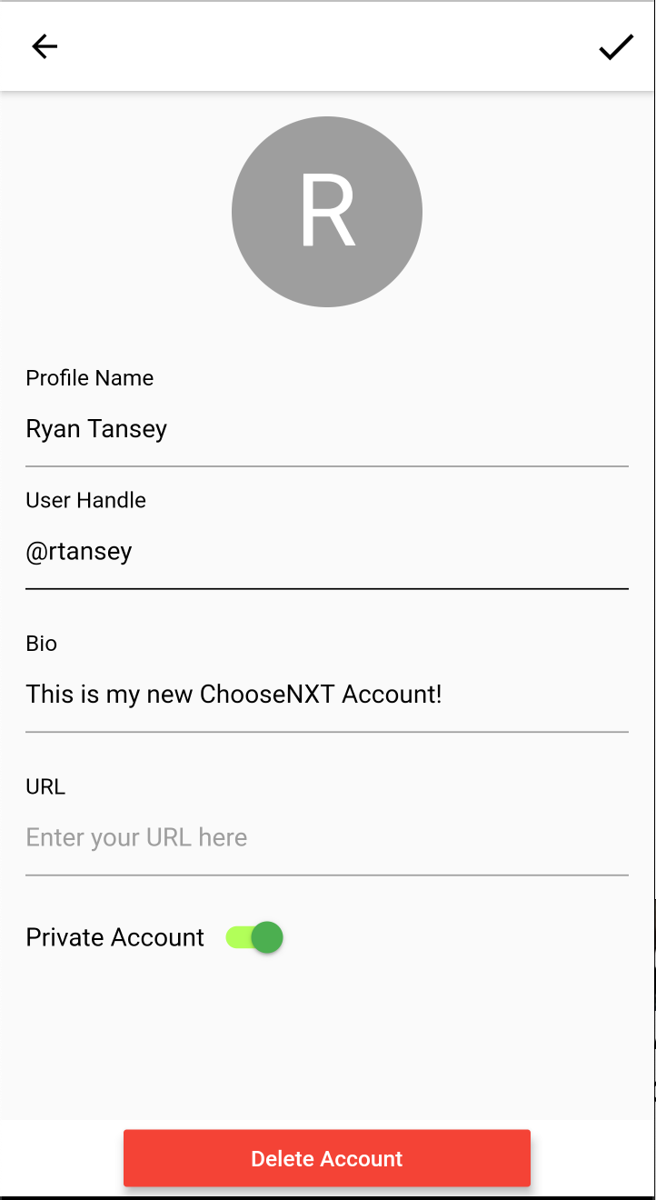
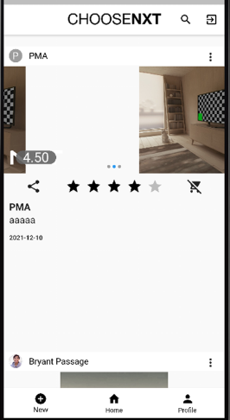

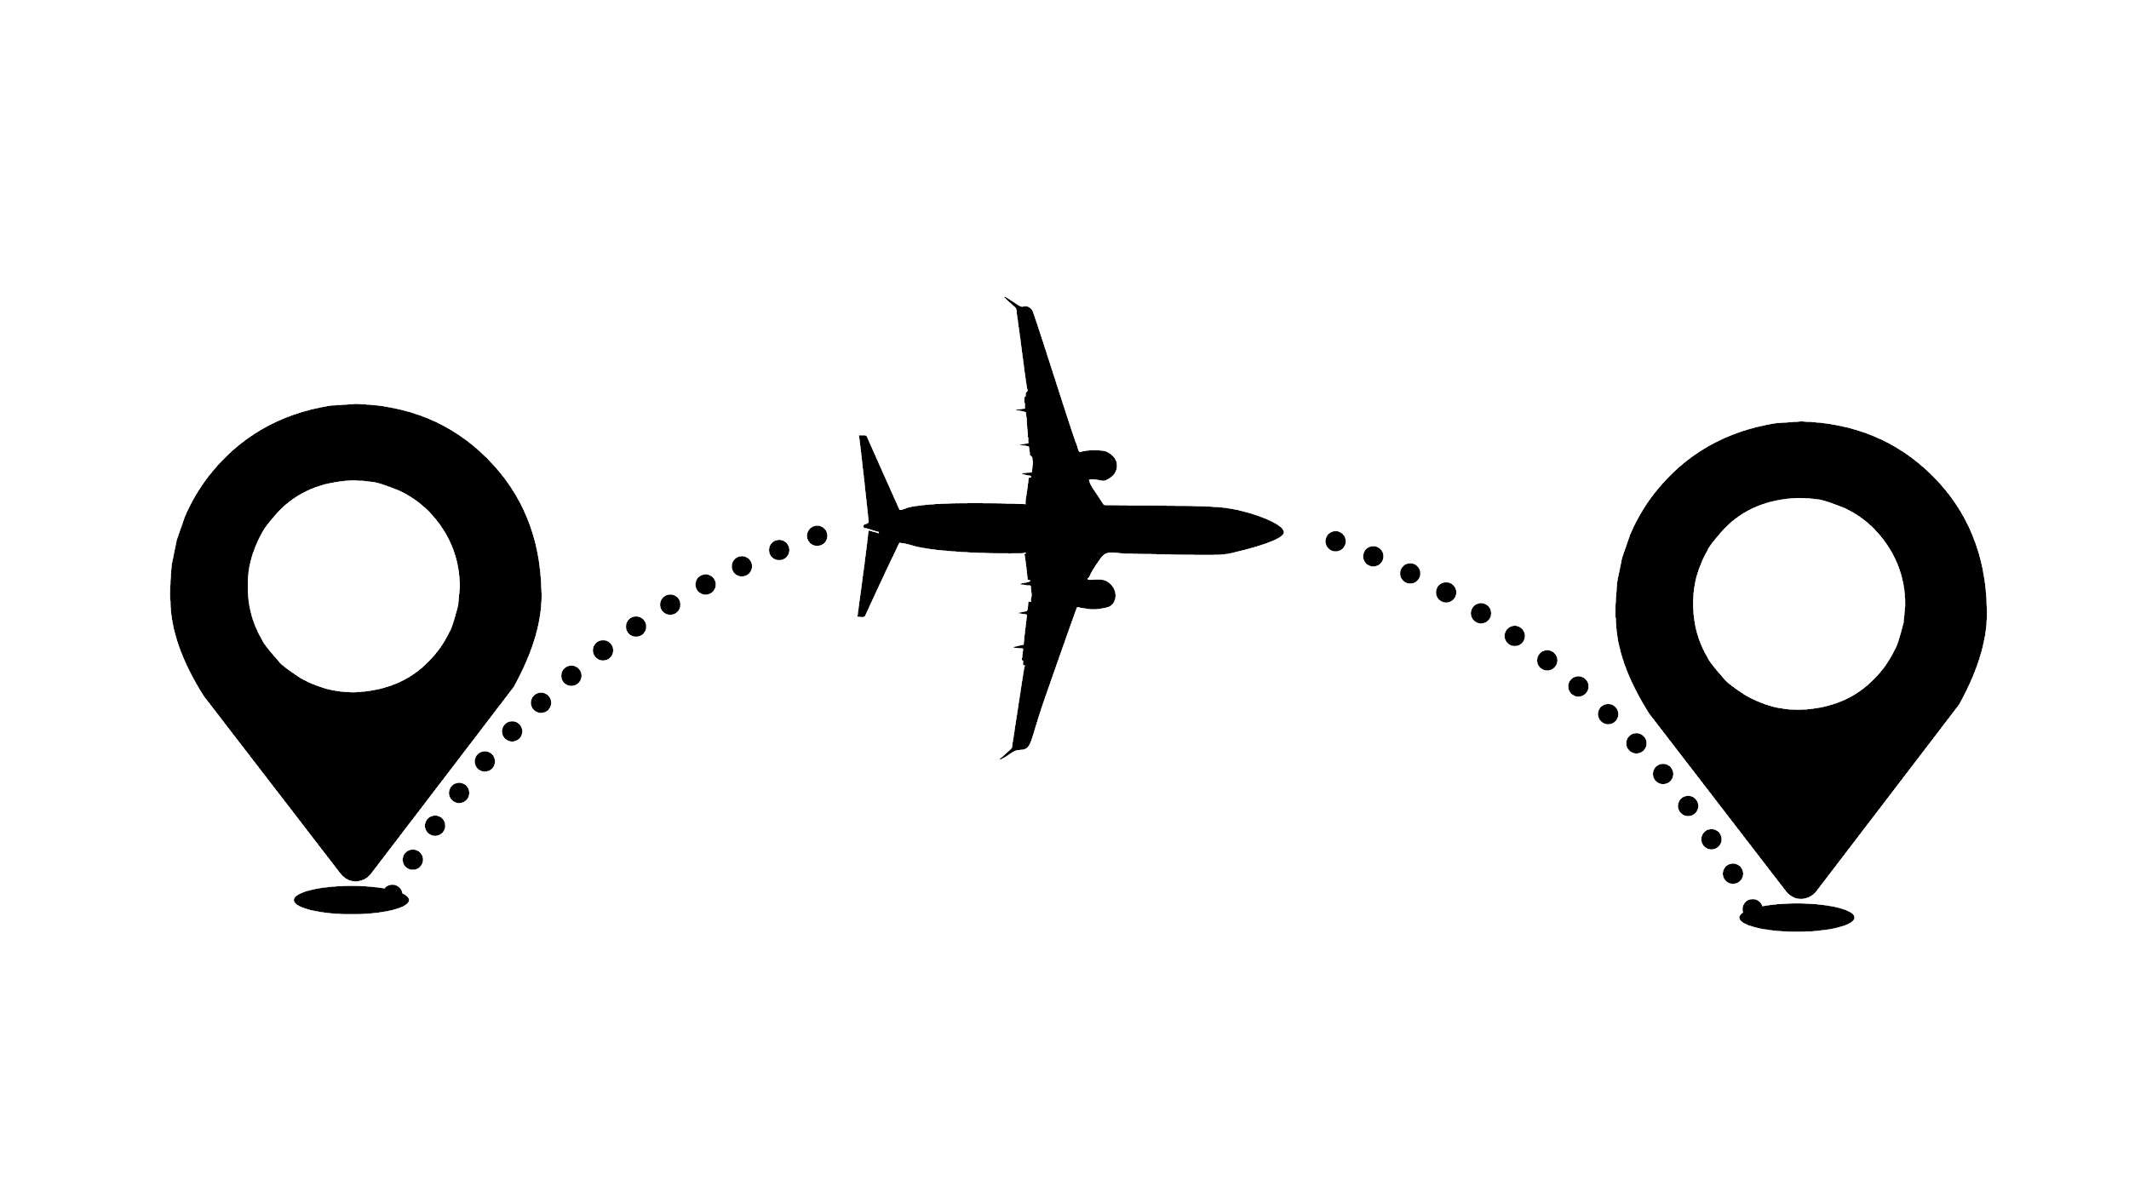
Laggies ChooseNXT Mobile App
Ryan Tansey, Corbin Petersheim, Rahul Murthy, Jingchen Xia
Instructors: Dr. Duncan Walker, Gayathri Krishna(CSCE 606-600)
Introduction
New Features
Mobile App Design Diagram
Scrum Iterations
ChooseNXT, founded by Tito Chowdhury, is a mobile application on both Android and iOS intended to create engagement and connection between patrons and fashion brands in order to drive sales and capture market analytics. The app is for brands - especially smaller businesses - to gauge interest and price acceptance of their prototypical or small batch products before investing in mass production, and for patrons to connect with cutting-edge fashion brands and gain exclusive access to their products.
1. Change user handle in edit profile
2. User confirmation pop up for block action
3. Image compression on upload
4. Set target price for a brand’s product
5. Attach multiple photos to single post
Iteration 0
Met with the customer, planned out some stories, and began looking at legacy code while trying to set up the development environment locally.
Iteration 1
Resolved dependency issues to build the project and successfully set up the development environment. Recorded necessary changes for future teams and began looking at some feature stories.
APK could be built at this point, but progress was blocked by app login issues, and there are no way to bypass the login screen of the app, even as developers. Dependent on Facebook/Google auth.
Iteration 2
Solved the login issues with Google Firebase. Successfully built and logged in to the project.
Continued making progress on features and chores.
Iteration 3
Continue working on features and chores
Project Framework
This project uses Google’s Dart language and Flutter framework. Dart is an object-oriented language with C# or Java style syntax, which can be used for both Android and iOS apps. Flutter, in addition to providing libraries, also acts as a dependency manager and package building tool.
Additionally, the app uses MongoDB - a noSQL data management system. The data is stored as JSON like objects called BSON rather than tables, which is different from the sqlite or postgres tables we discussed in the course. Most of the controller methods accessing the database already exist, but it is a good idea to understand the structure of the data. The Android app side relies on Gradle for building, and the iOS app requires XCode on Mac hardware.
Challenges
• We ran into our first problem when our first customer (Big Event committee) informed us that the project we were assigned to had already been completed since they needed it done much earlier than when we would have finished it. By the time we met with our new customer (Tito), it was late in the semester and Iteration 0 had been complete for other teams.
• Another unexpected situation we ran into was that one of our team member dropped the course without informing anyone, so we were not only short on time, but on manpower as well.
• Working with this legacy project proved to be difficult. Flutter, Dart, Android and iOS development was new to all of us, and between Spring 2021 and now there were significant changes to the Flutter framework that broke the existing codebase. Debugging and fixing the dependencies to get an APK to build took a significant amount of time leading to setbacks.
• The previous groups environment set up guidelines were not detailed enough on what versions of Flutter/Dart/Gradle were used and how to connect to Firebase for authentication. Without getting through the login, no changes to the code could be observed and tested, so that was another setback
Future Work
The things we feel are most important to implement in the next iterations
• Improve algorithm / identify bottlenecks for loading
• Build iOS app and publish on the App Store
• Unblock Facebook login feature
• Differentiate between a Brand and a Patron account to allow for richer features and interactions
Team Roles
Starting Roles
Ryan Tansey - Scrum Master
Corbin Petersheim - Product Owner
Rahul Murthy - Member
Jingcheng Xia - Member
Current roles
Ryan Tansey - Scrum Master
Corbin Petersheim - Product Owner
Rahul Murthy - Developer
Jingcheng Xia - Developer
Acknowledgements
Thank you to Tito for working with us and providing us with a project on a short notice.
Thanks to the Spring 2021 team for getting on a 2 hour call with us to try and solve our problems.
Thank you to Dr. Walker and Gayathri for working with us and understanding our situation.

